Slide 1
Vision-Based Robbery Detection
Final Year Project
Prototype submission
Student Name: Iffat Zahra
Supervisor Name: Haseeb Akmal
Student ID: BC210426306
Group Id: S2302941B9

Slide 2
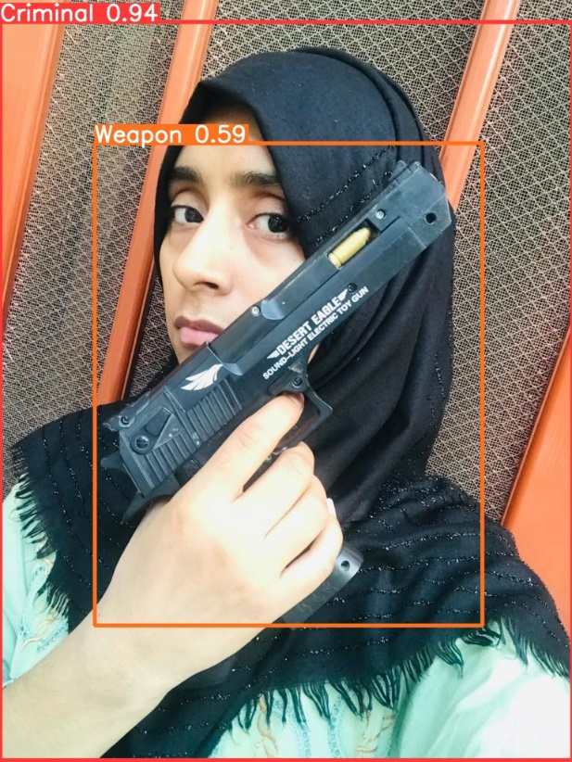
Project Guide Document Vision-Based Robbery Detection
This document serves as a comprehensive guide for planning and executing a project aimed at leveraging computer vision to enhance public safety through real-time robbery detection and prevention. It outlines the current project status and details the methodologies employed thus far in pursuit of this objective.

Slide 3
Steps for making dataset

Slide 4
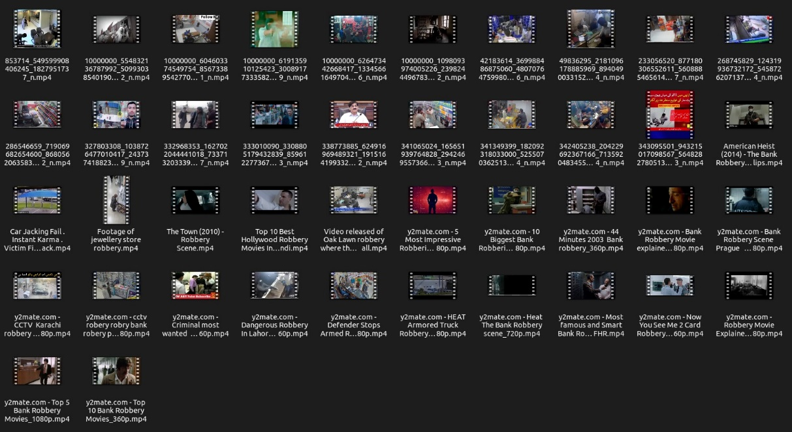
Step 1:
Firstly, I collected videos from different social media platforms about robbery.

Slide 5
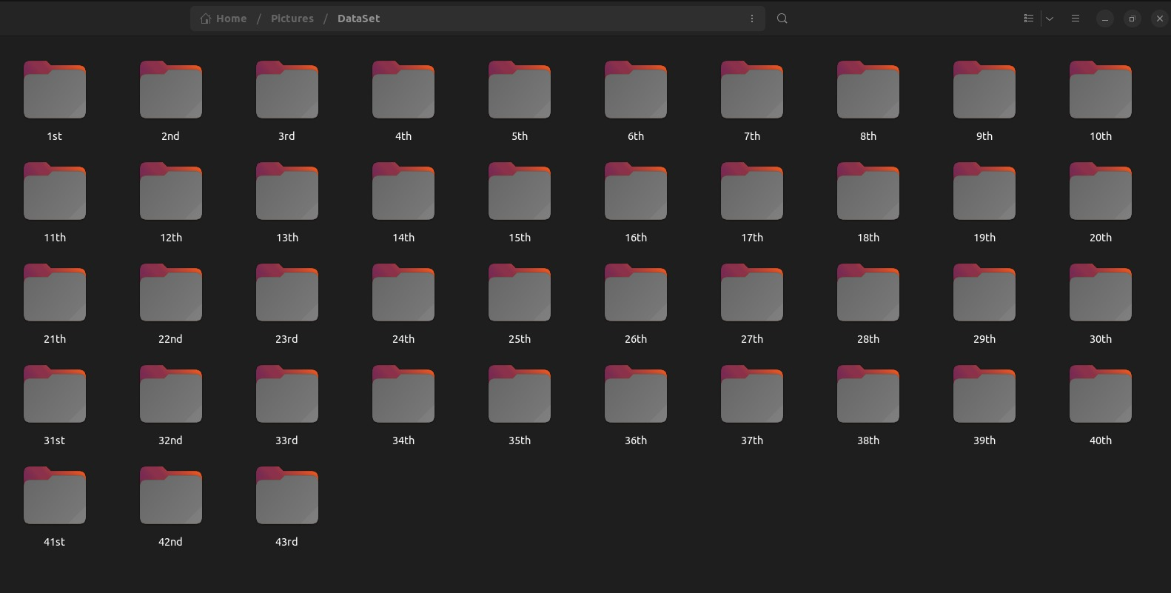
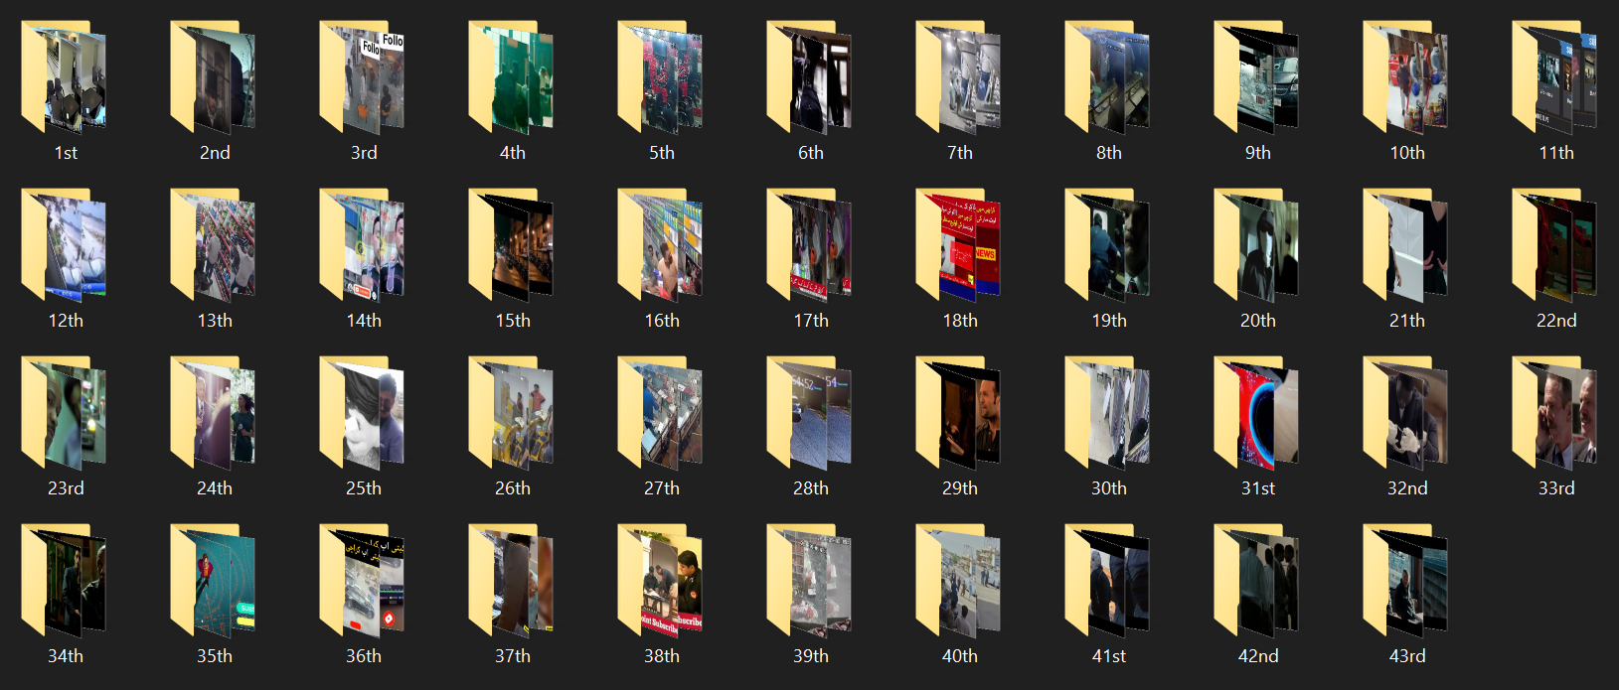
I converted the videos into frames using VLC media player at 1-FPS.
Step 2:

Slide 6
Dataset Cleaning

Slide 7
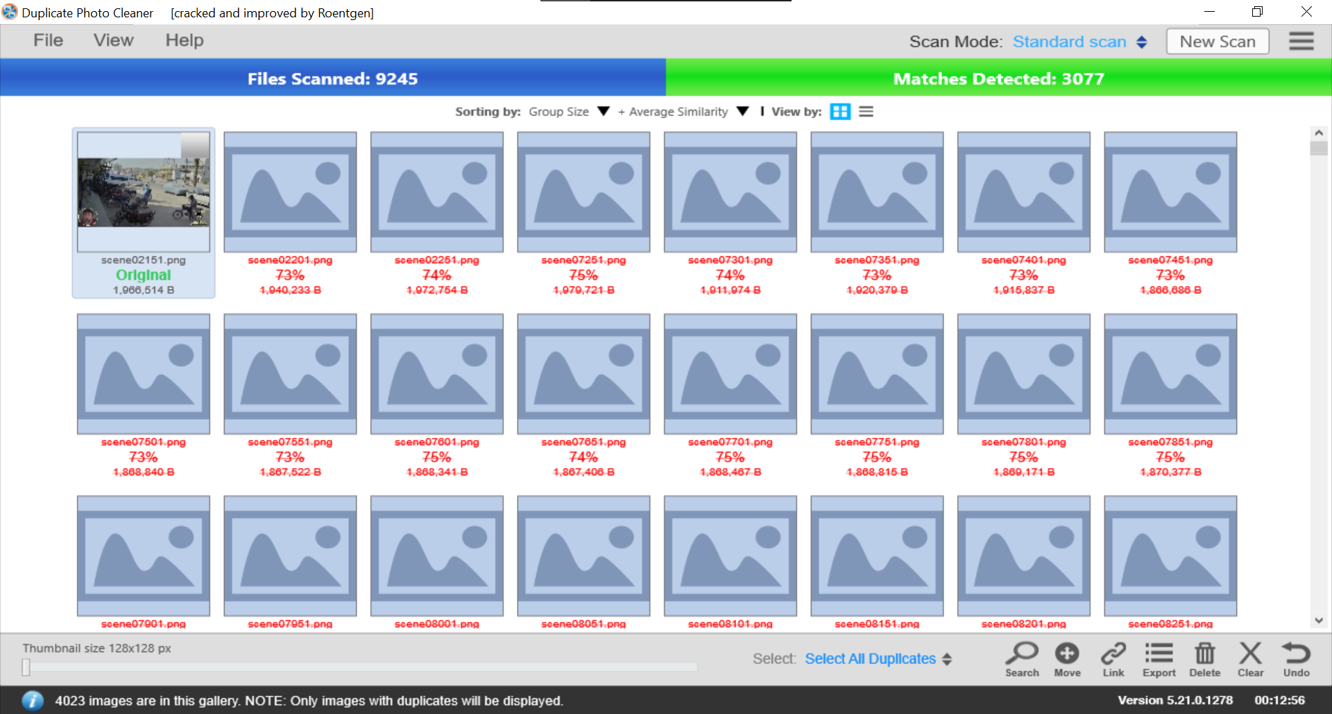
To make a more diverse dataset, I used Duplicate photo cleaner software to remove duplicate images from the Dataset at a 60 percent similarity threshold to make a more diverse dataset.
Remove Similar Images

Slide 8
After making the Dataset, I uploaded the extracted frames on Roboflow to apply the annotation to images

Slide 9
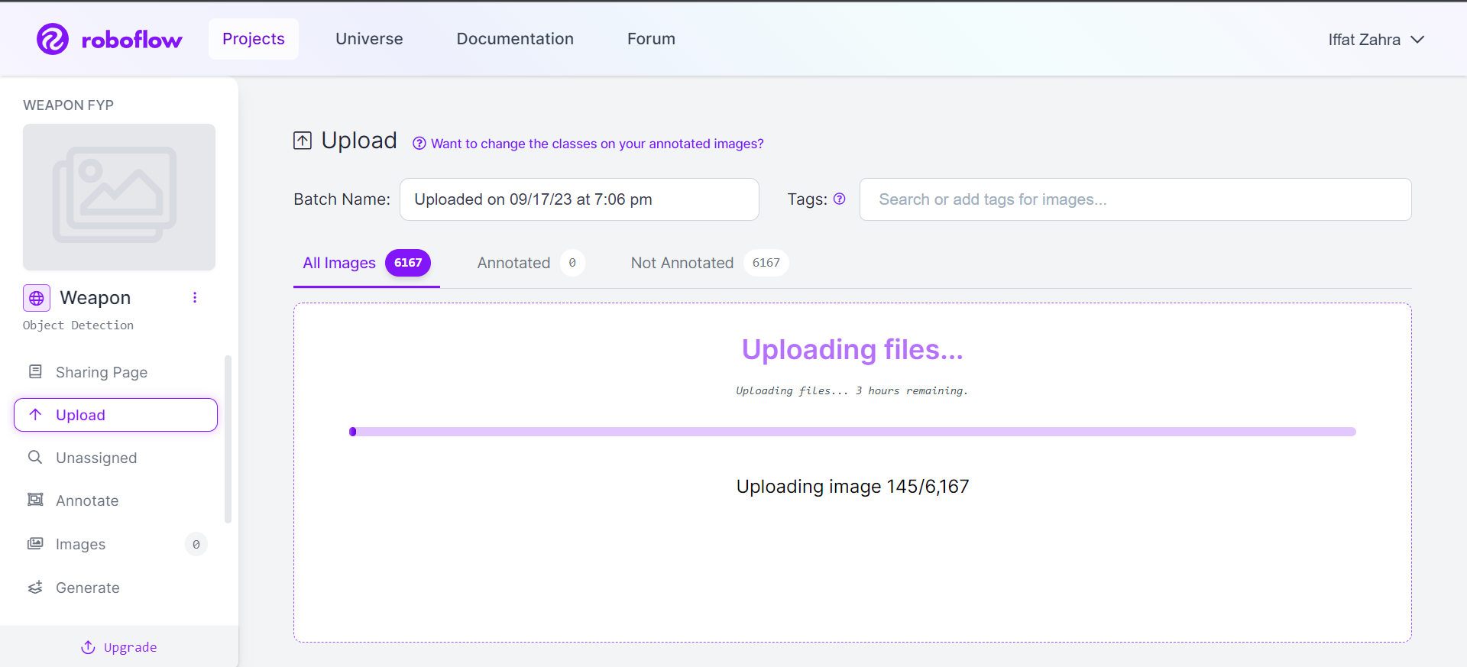
I am uploading dataset on roboflow, it contains 6,167 images after removing the duplication
Step 1:

Slide 10
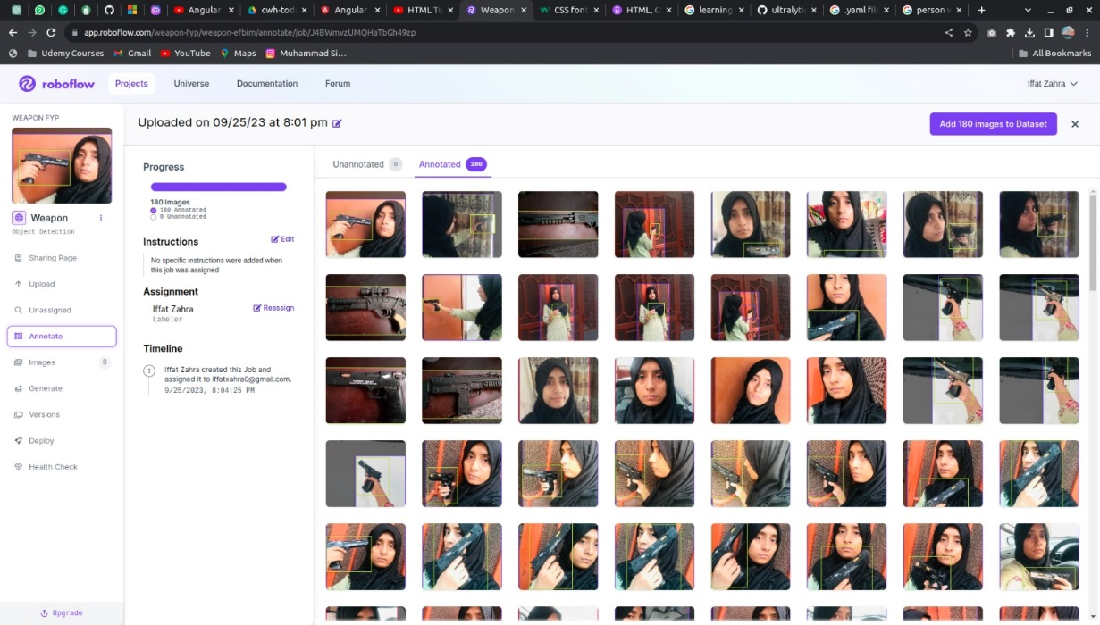
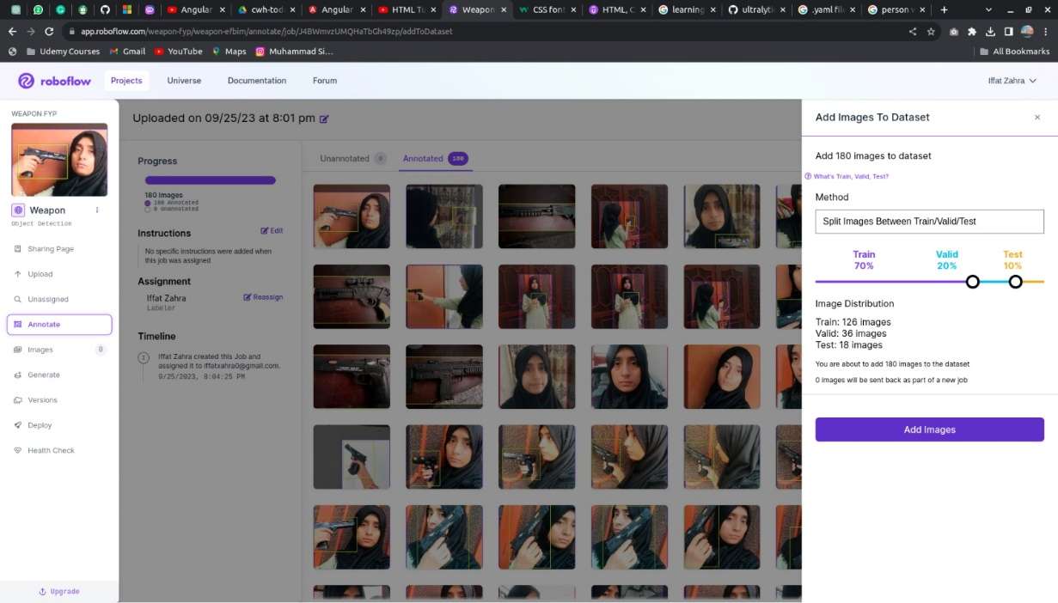
I split my dataset for train, valid, and test
Step 2:
I annotated dataset with 3 different classes.
Weapon
Criminal
Person (person without weapon)
Step 3:
80 percent for training
10 percent for testing
10 percent for validating

Slide 11
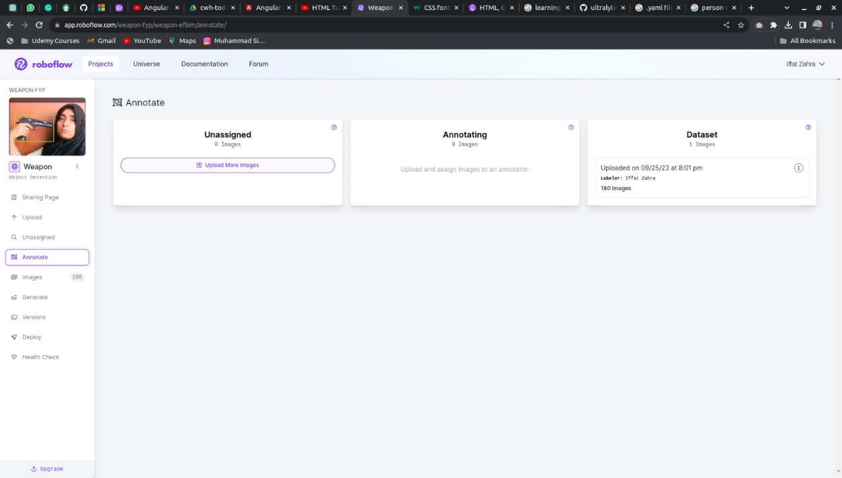
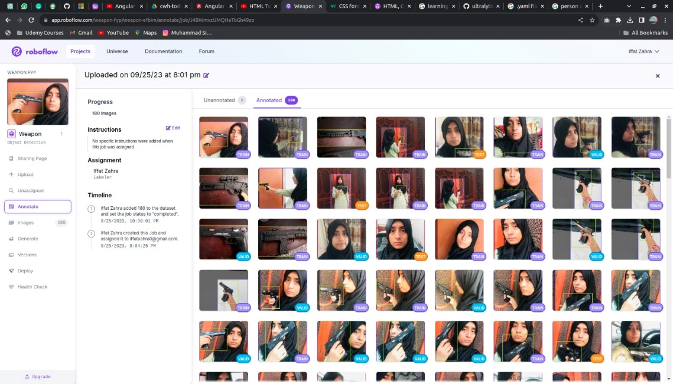
After annotating the image, I added annotated images to the dataset and Roboflow automatically split annotated images into training, testing and validation accordingly
Step 4:

Slide 12
Preprocessing on dataset

Slide 13
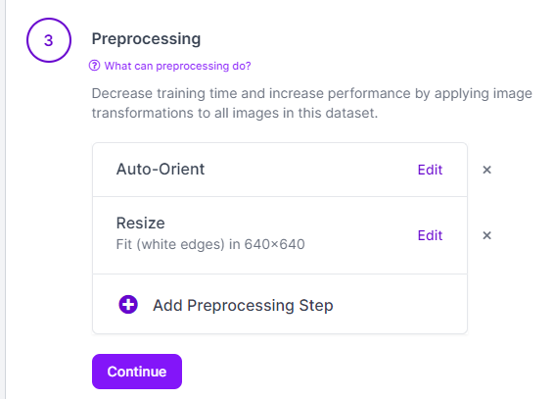
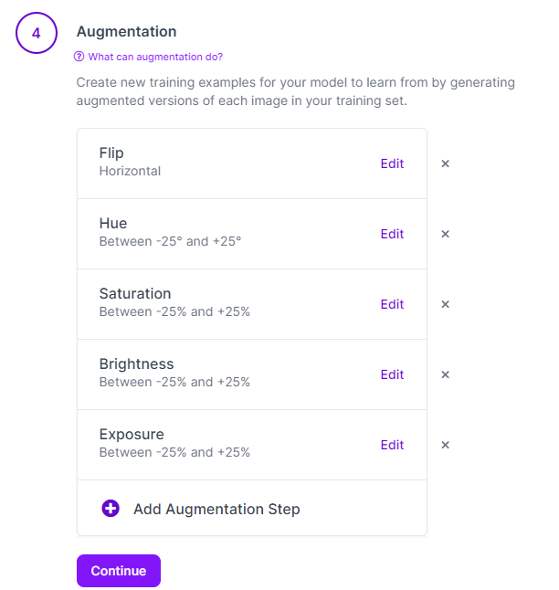
I applied the following preprocessing to the dataset. 1. Auto-Orient 2. Resize 640 x 640
Step 1:
Step 2:
To make a more diverse dataset, I applied different augmentations as mentioned in the picture. Augmentation can also help to avoid overfitting

Slide 14
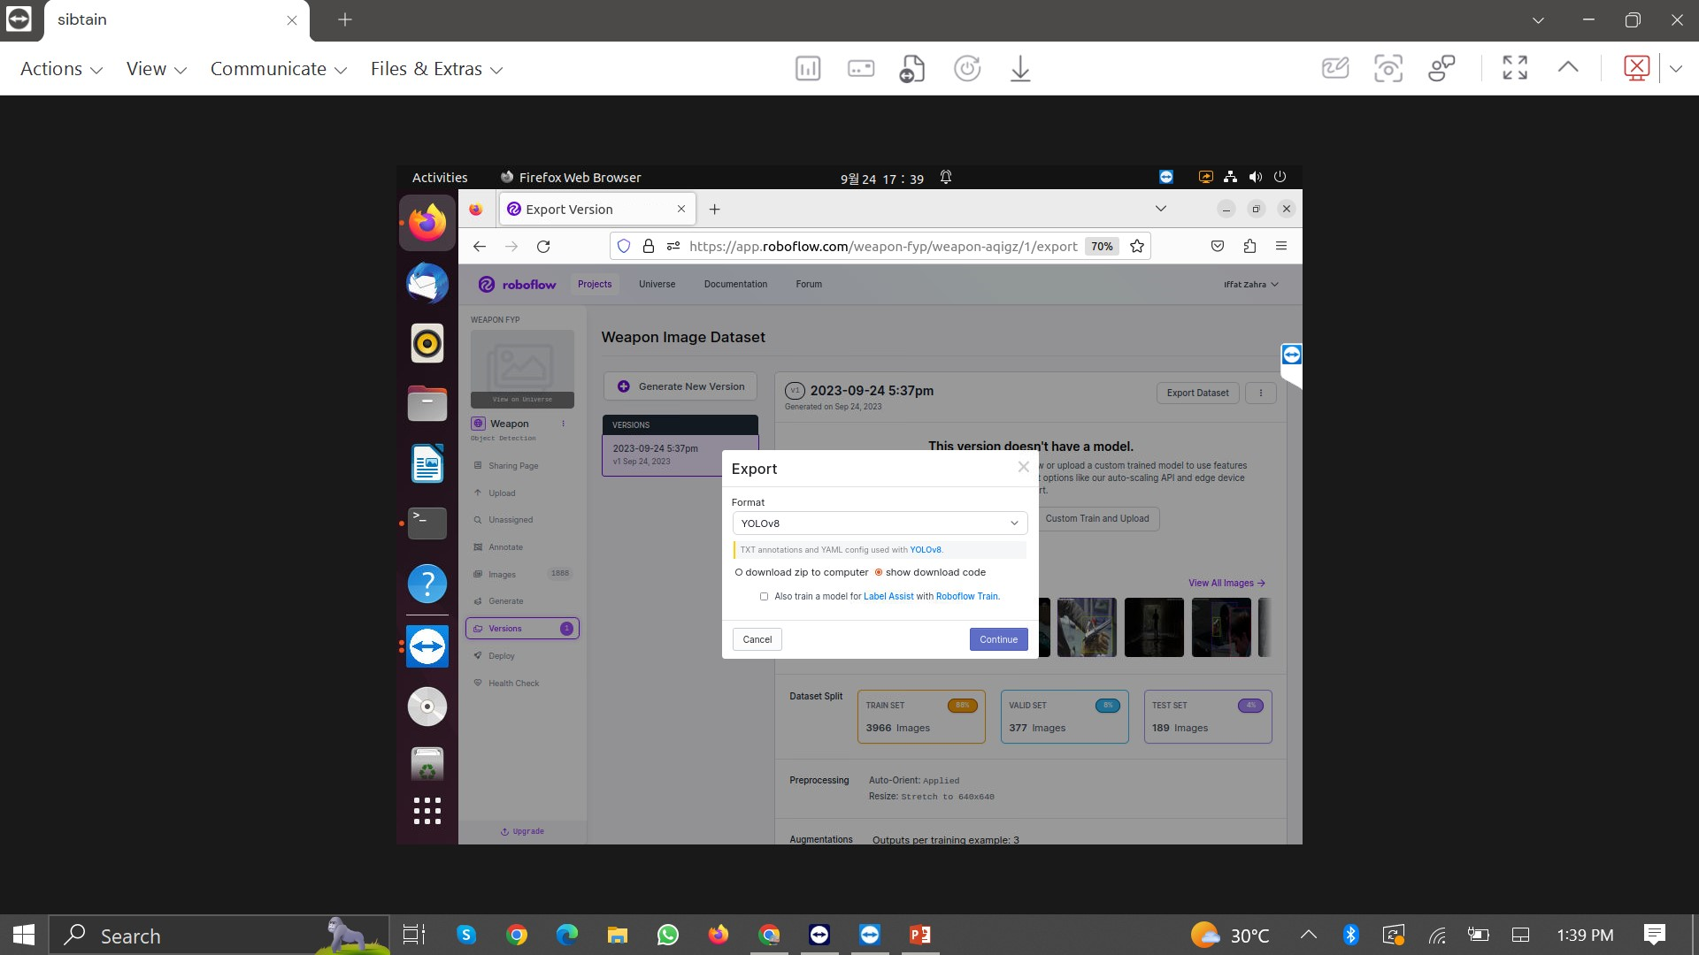
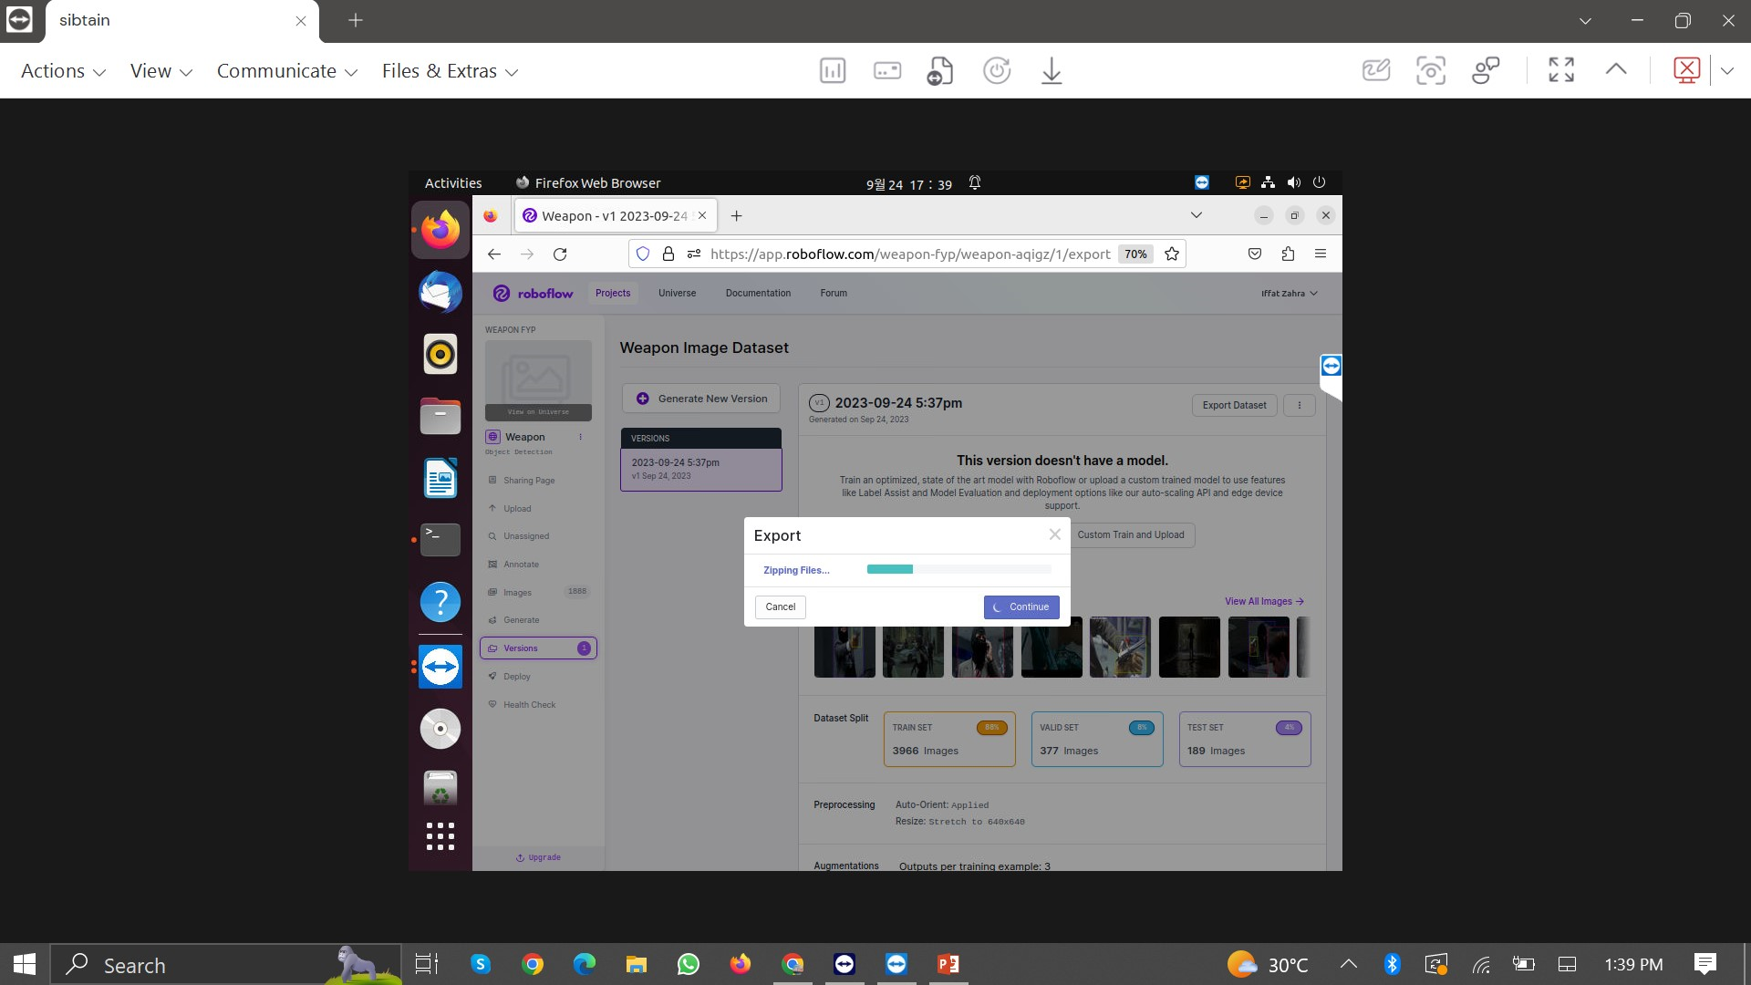
I export the dataset in yolov8 format to train model
Download the generated version of dataset

Slide 15
Preparing Environment for Yolov8

Slide 16
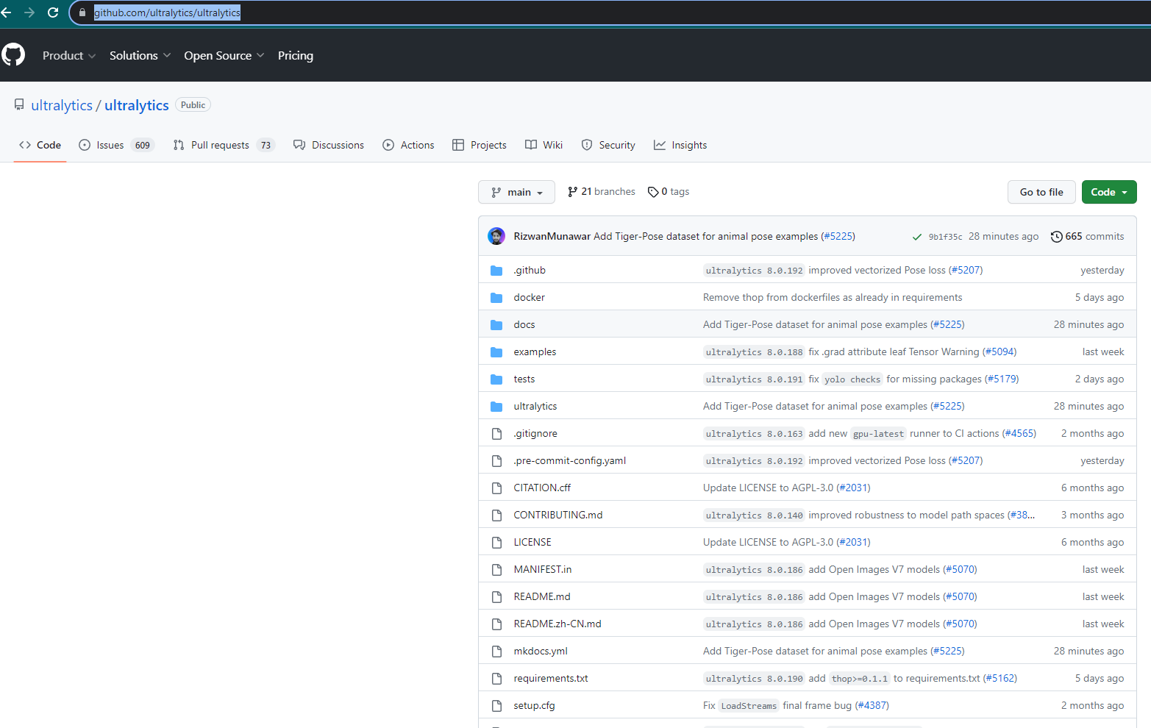
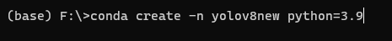
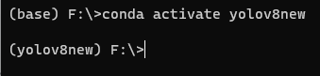
Download the code of yolov8 from the official ultralytics GitHub web. https://github.com/ultralytics/ultralytics
Step 1:
Step 2:
Make a separate yolov8 environment on Anaconda
And setup libraries for yolov8

Slide 17
Training yolov8 model on custom dataset

Slide 18
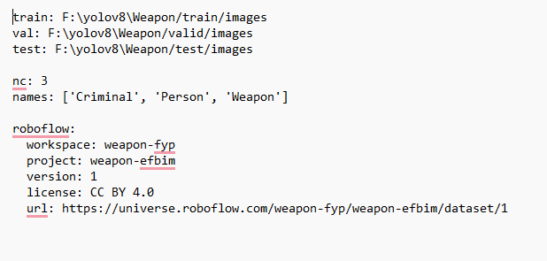
Copy and unzip the custom dataset into the yolov8 folder and update data.yaml path to absolute path
Step 1:
Step 2:
I select the following hyperparameter to train the model
Hyper-parameter | values
Epochs | 300
Image-size | 640 x 640
Batch | 32
Optimizer | SGD (Auto)
Learning rate | 0.01 (auto)

Slide 19
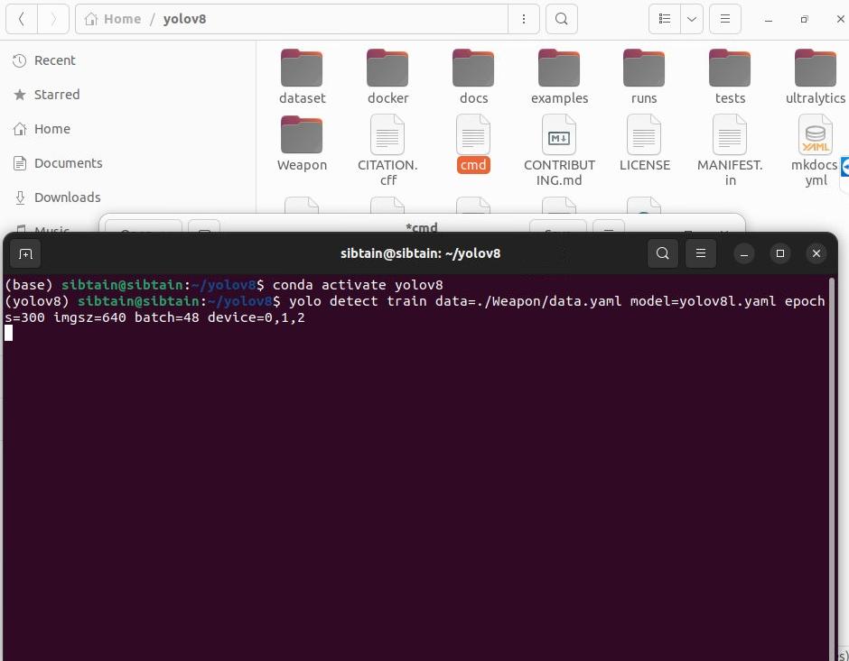
Step 3:
I used the following command to train the model
yolo detect train data=./Weapon/data.yaml model=yolov8l.yaml epochs=300 imgsz=640 batch=32 device=0,1,2

Slide 20
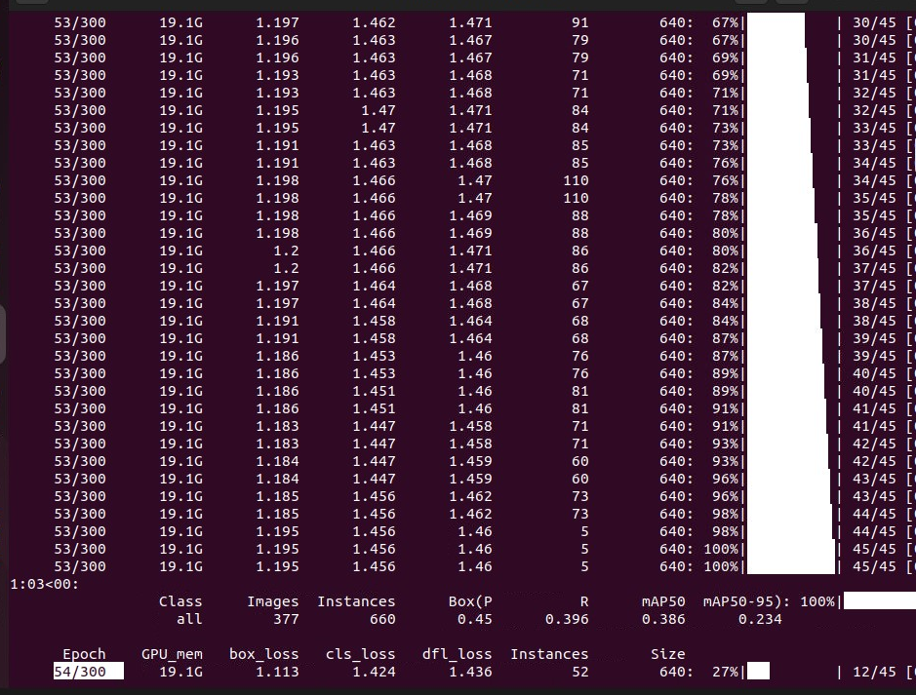
Step 4: These are the details of training Dataset during training at 54 Epoch

Slide 21
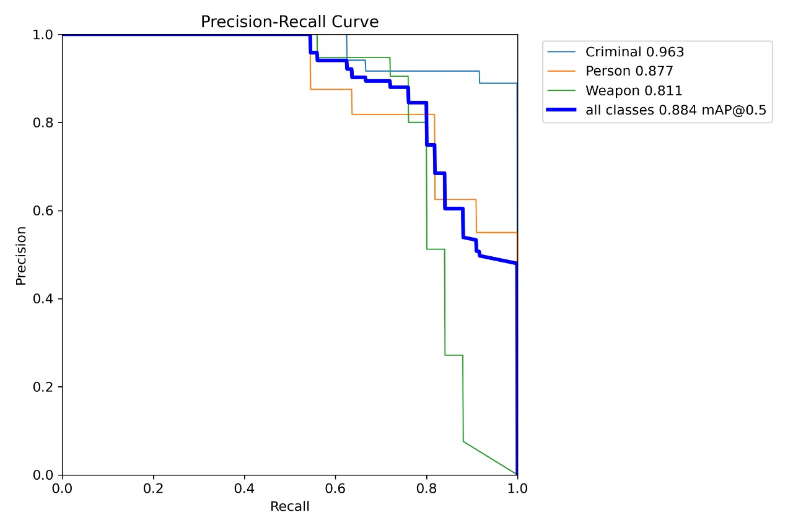
Step 5: This is the result of Dataset training and best.pt file weights are shown

Slide 22
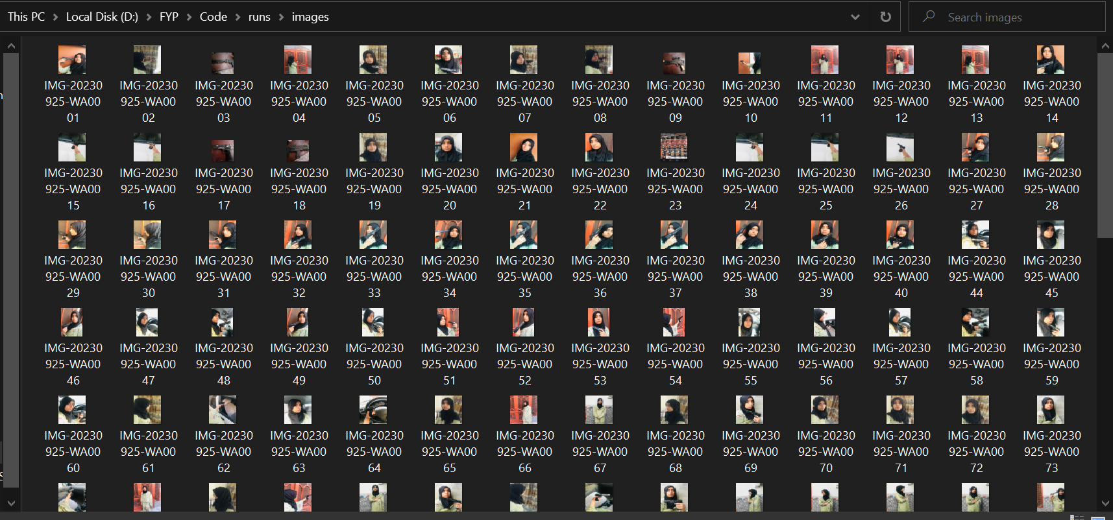
Step 6: I uploaded sample images to check whether my system detect these images or not, these are my own dataset for this project

Slide 23
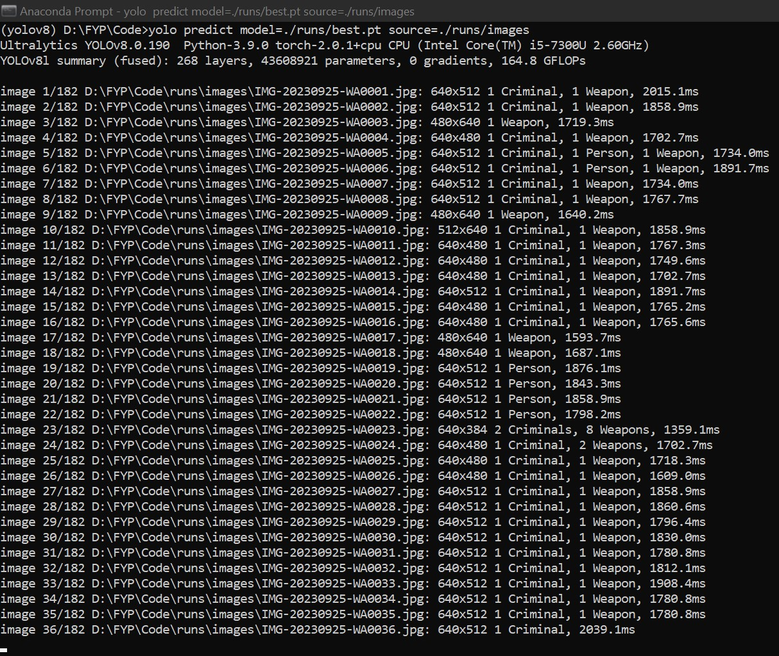
Step5: This is the view in which my system detected the images(Criminal, Person, Weapon) Command: yolo predict model=./runs/best.pt source=./runs/images

Slide 24

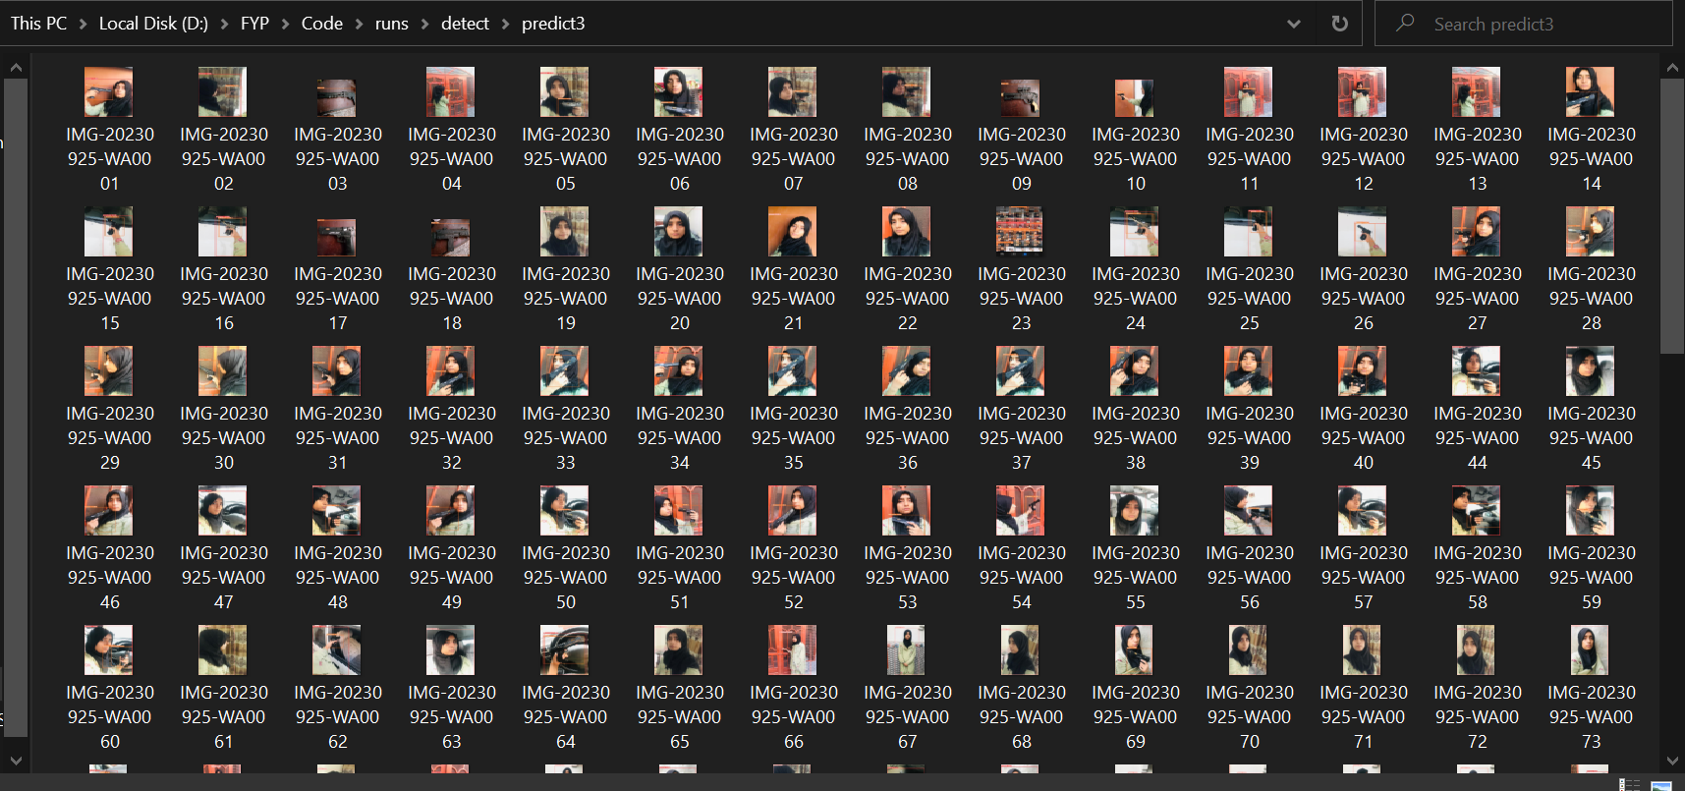
Step6: These are the predicted images that are detected by my system

Slide 25
After training the dataset the result is given, Now I have to integrate these things with its Desktop application GUI

Slide 26
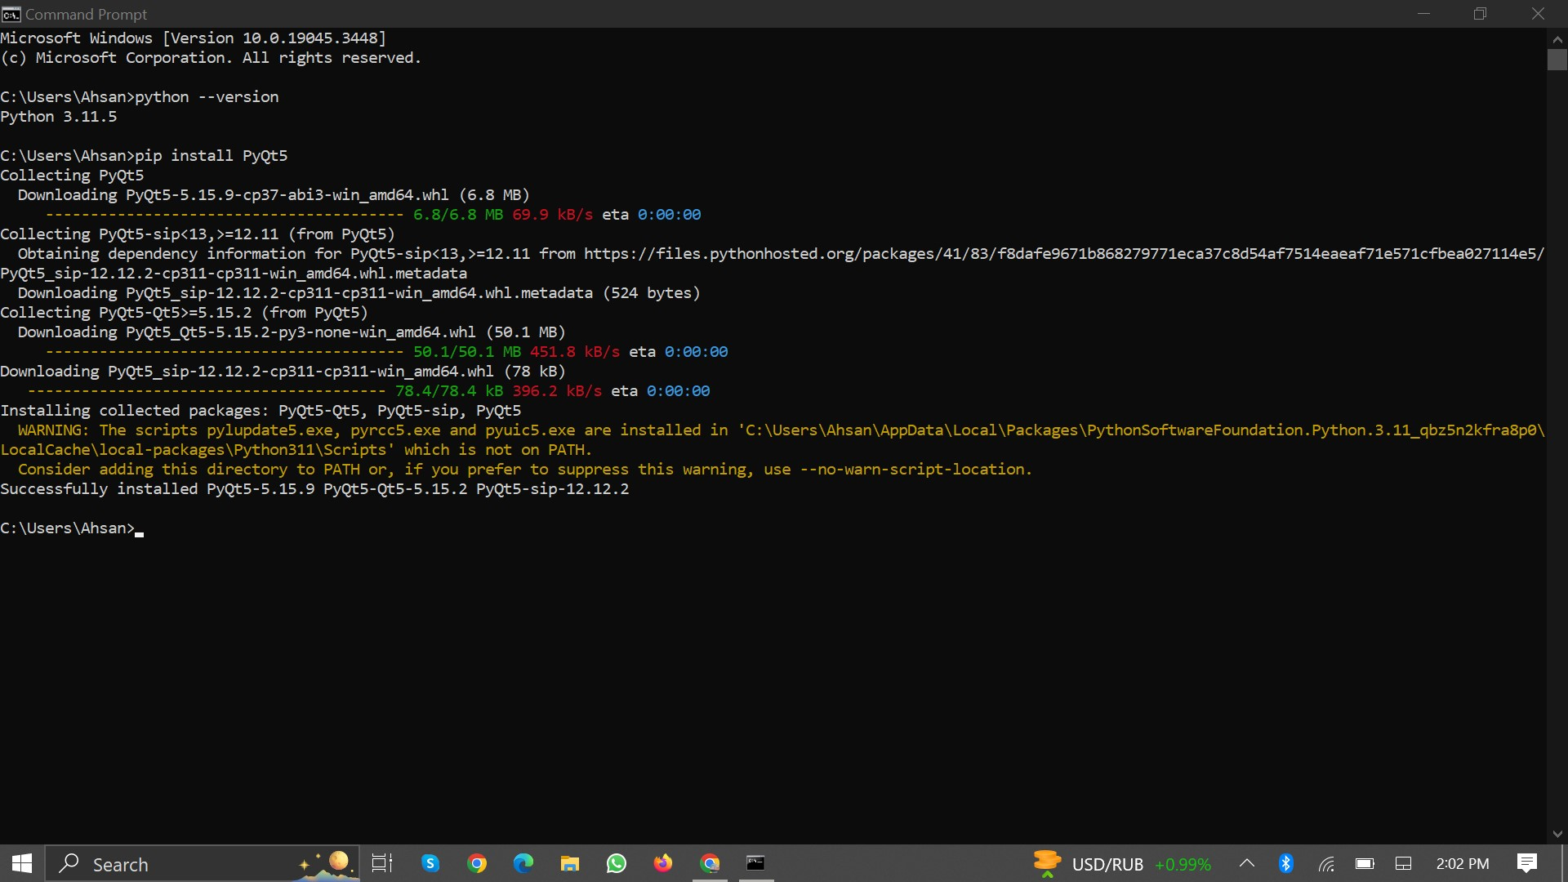
Step1: Firstly I installed PyCharm and PyQt5

Slide 27
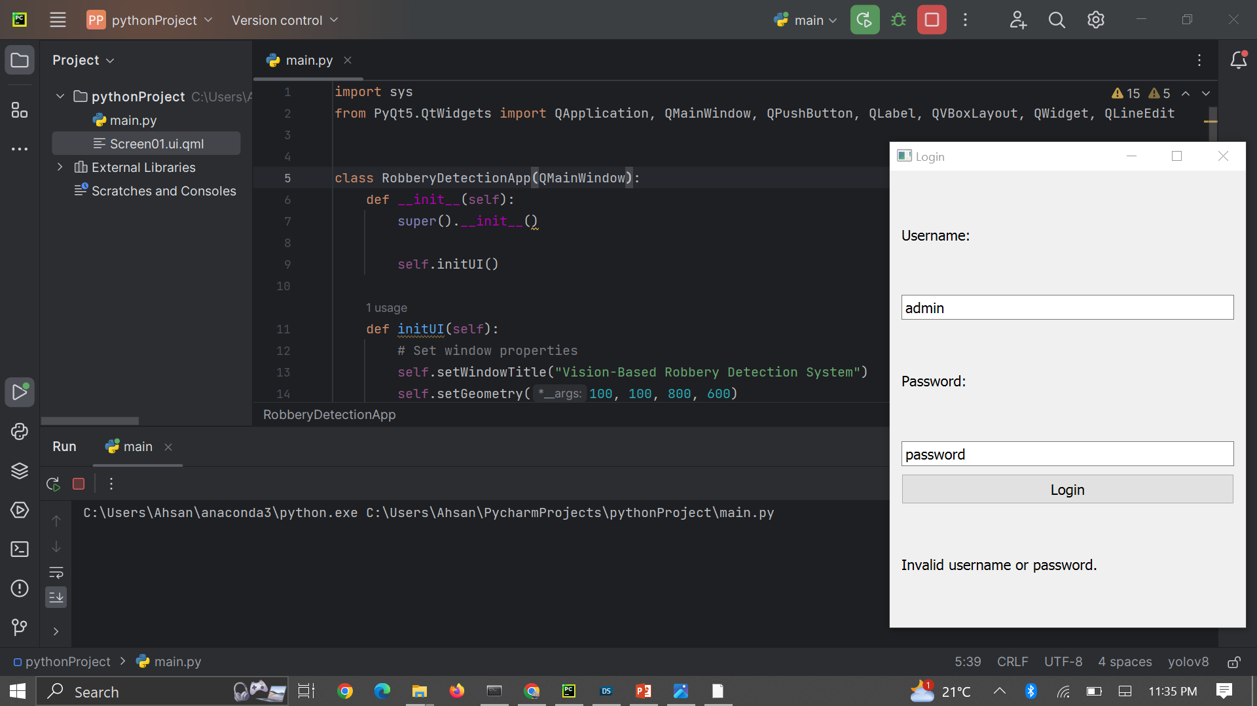
Step2: I started the development of the GUI

Slide 28
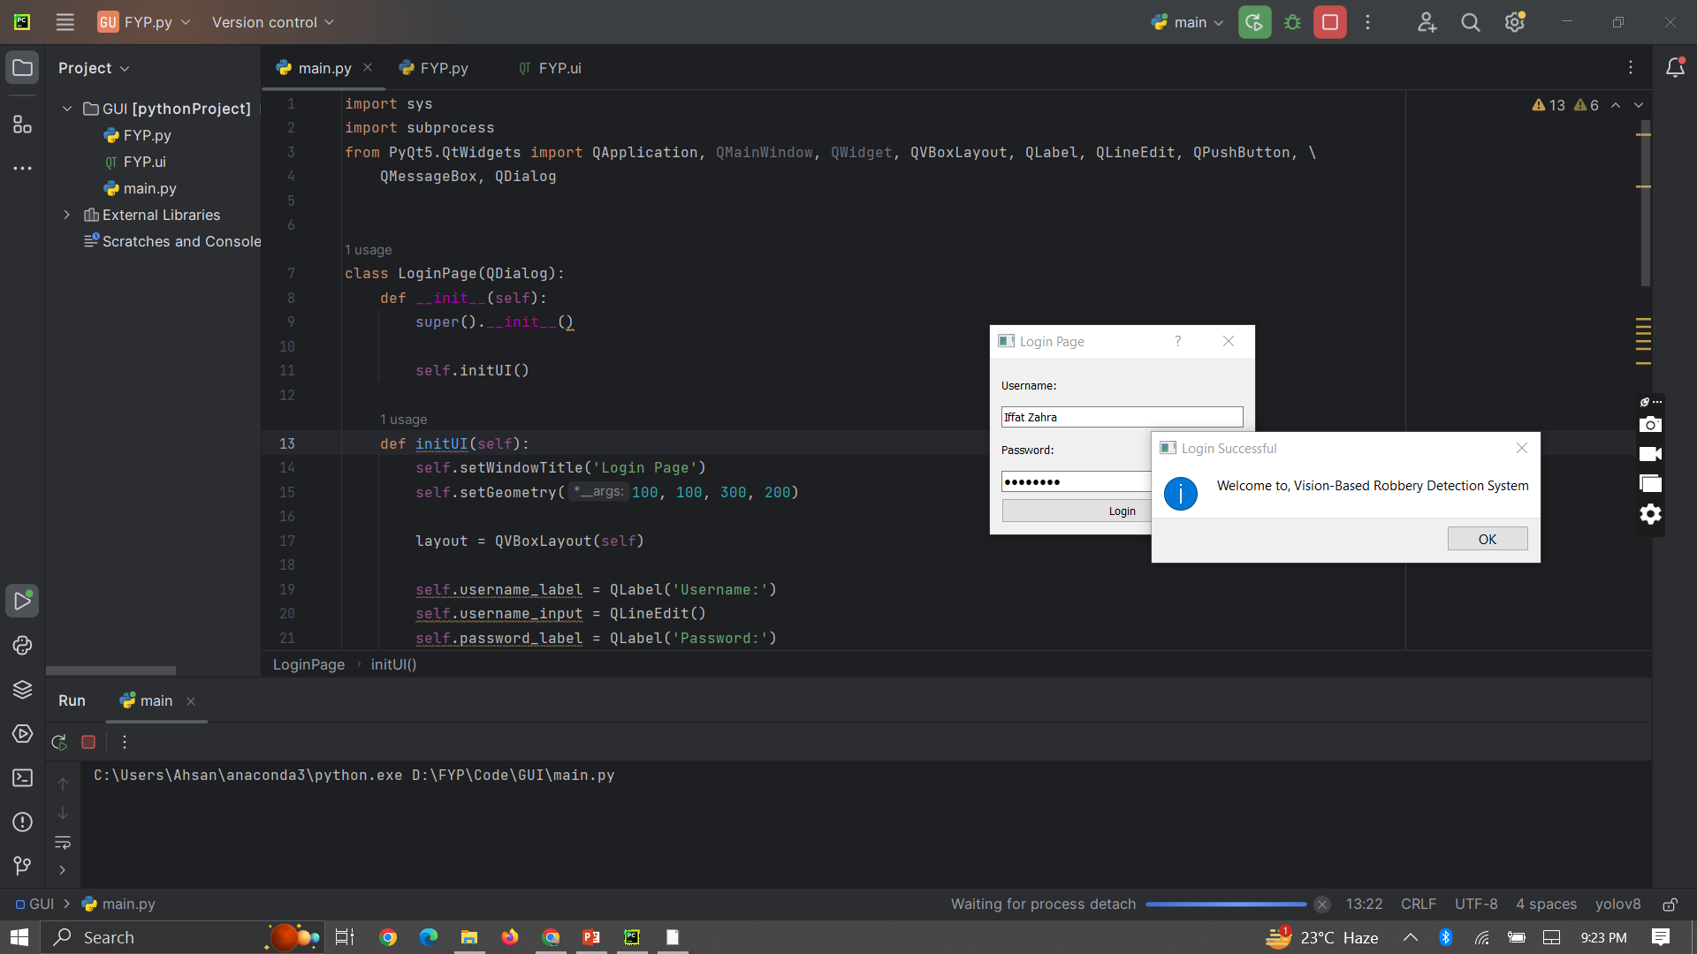

Slide 29
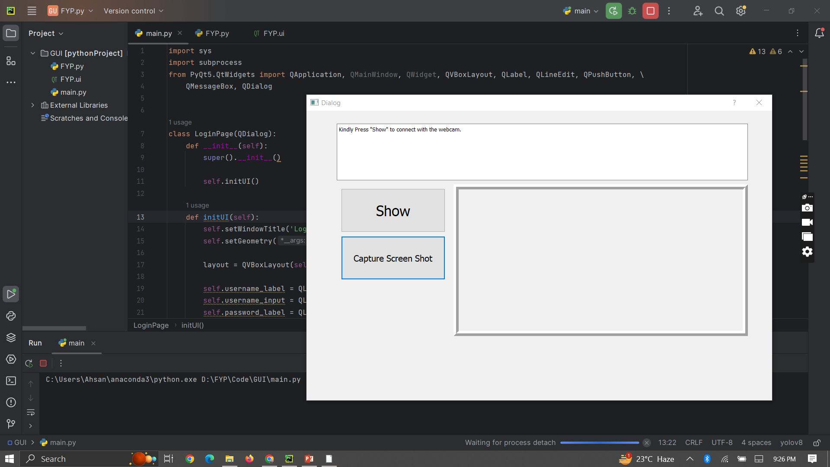

Slide 30
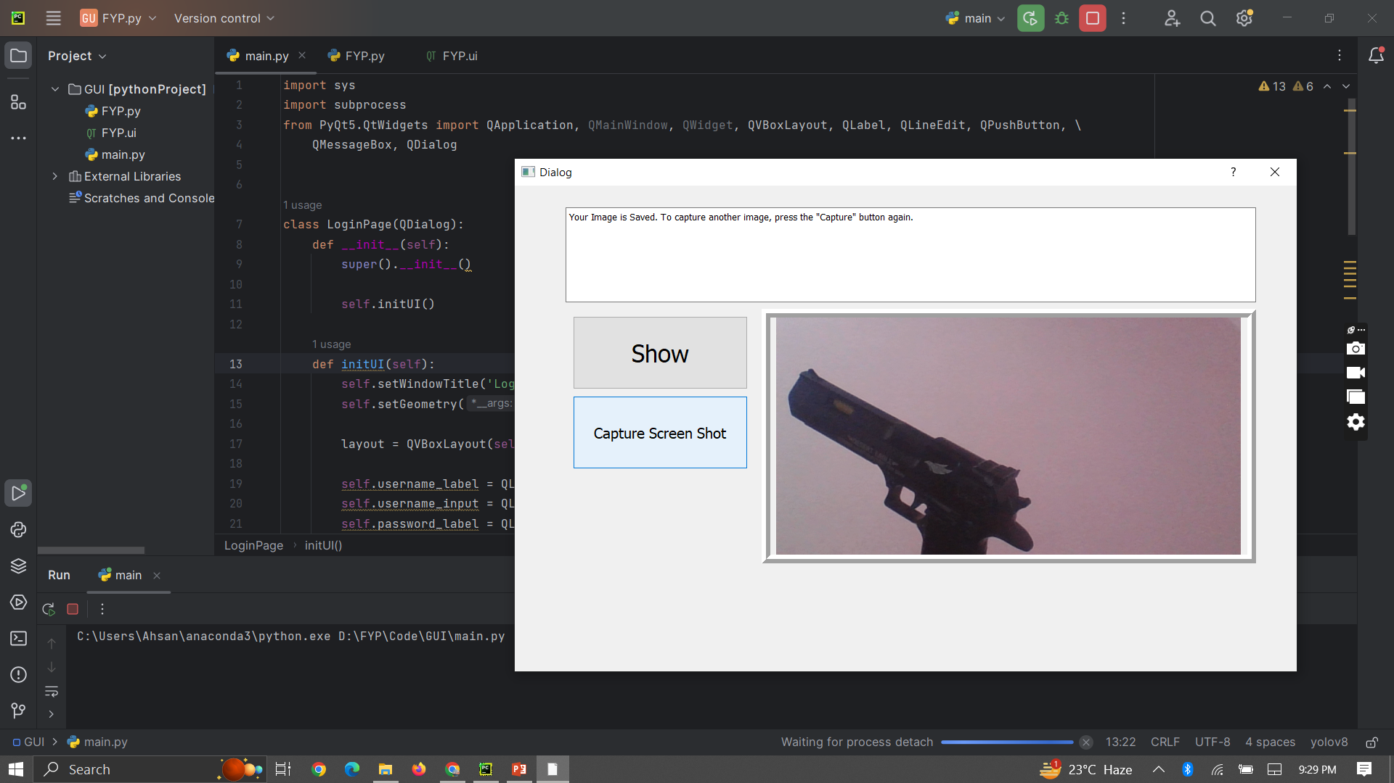

Slide 31
Thank you!

